Slide 1
Datos y cosas aux de N reinas QUBO

Slide 2
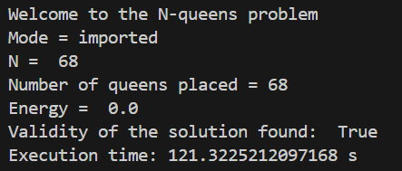


Passing dictionarys of the diagonal and off diagonal terms
hybrid
Sim annealing 109
Passing an np matrix

Slide 3



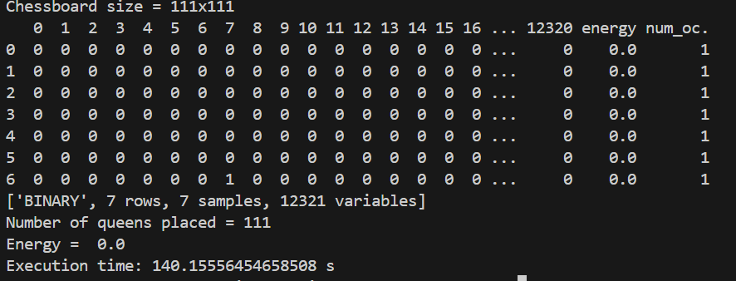
Sim annealing 110
Sim annealing 109 – 10 reads
Sim annealing 115 – 10 reads
Sim annealing 110 – 10 reads
Sim annealing 111 – 10 reads

Slide 4
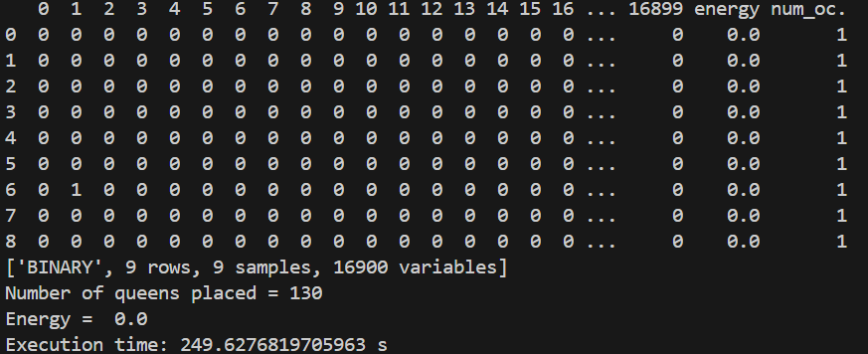
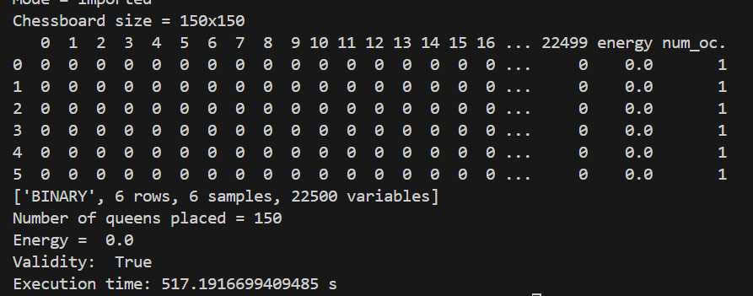
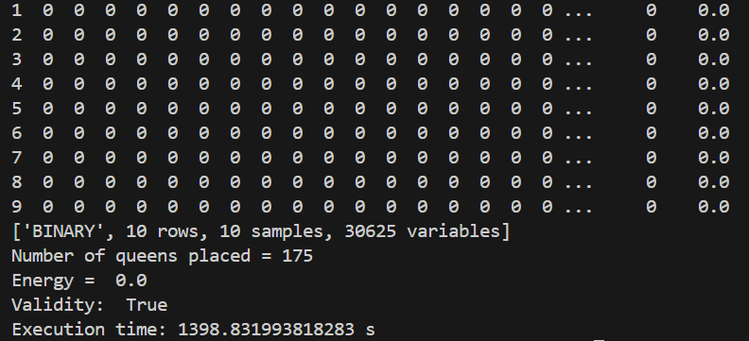
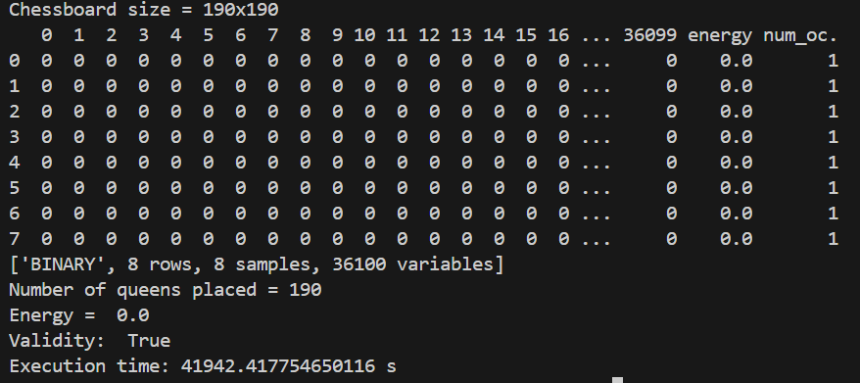
Sim annealing 130 – 10 reads
Sim annealing 150 – 10 reads
Sim annealing 175 – 10 reads
Sim annealing 190 – 10 reads

Slide 5
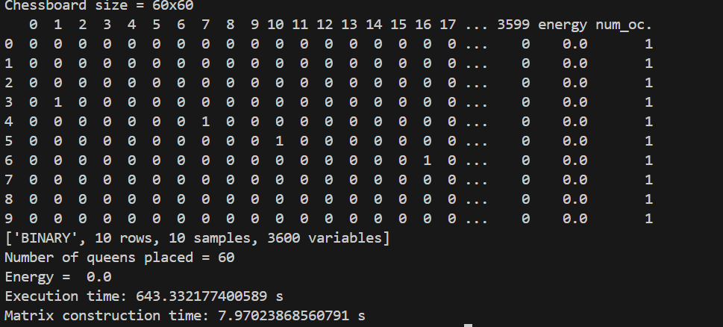
Kerberos

Slide 6
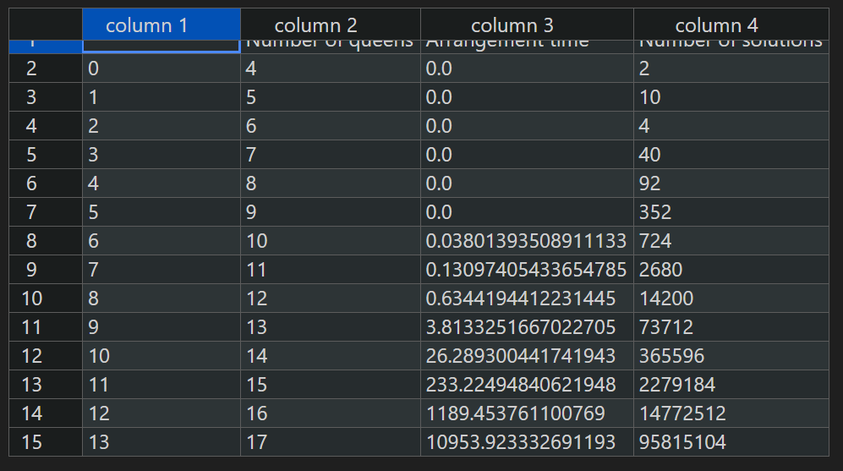

Slide 7
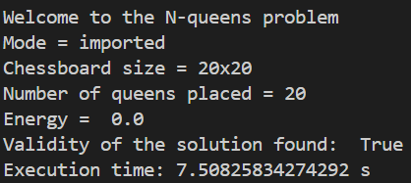

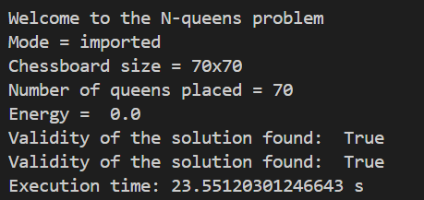
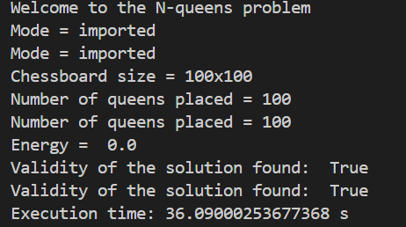


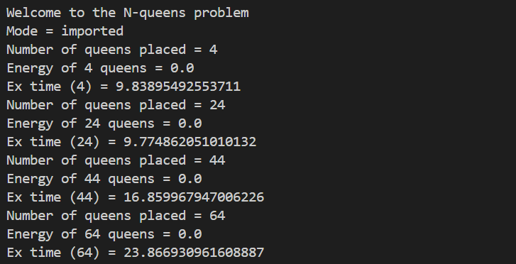




Hybrid

Slide 8
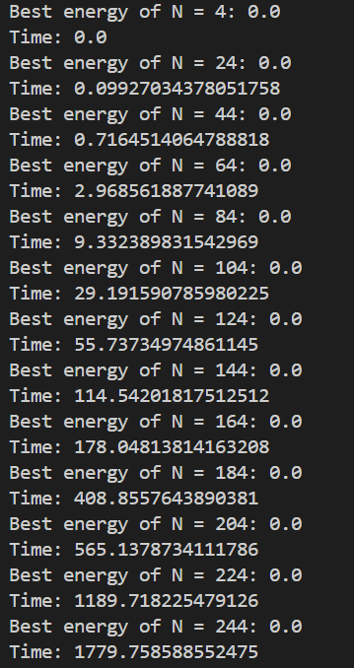

Sim ann

Slide 9
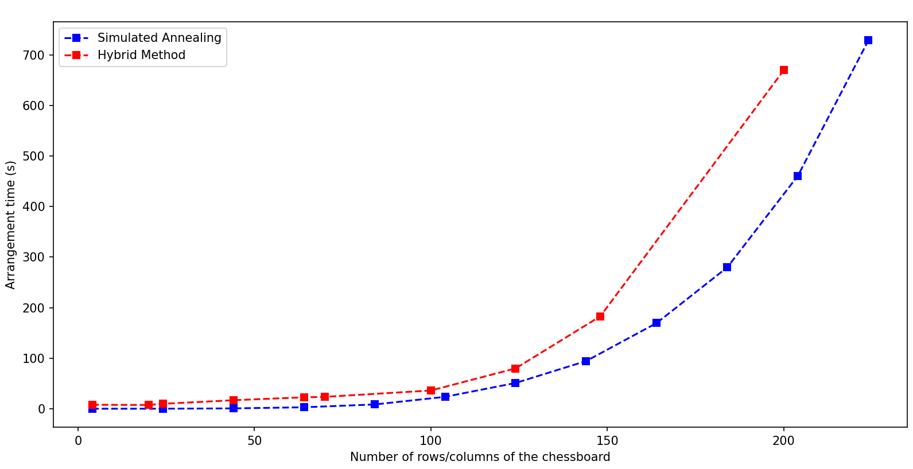

Slide 10


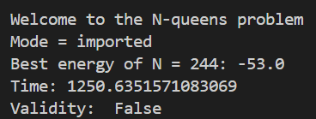

hybrid
SIMULATED ANNEALING

Slide 11


Hybrid
Hybrid

